Slide 1
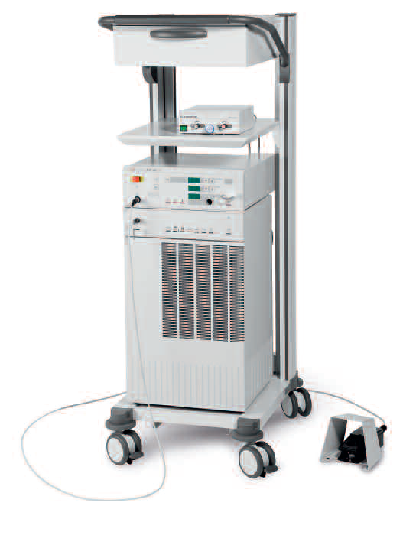
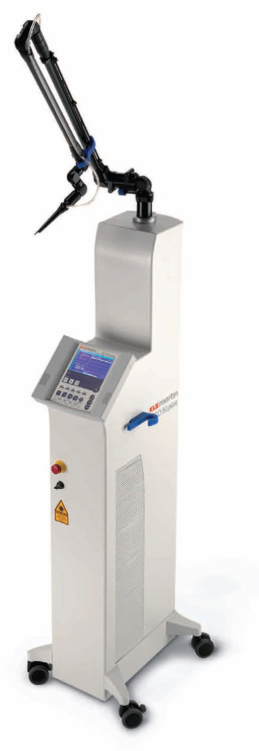
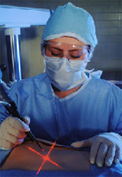
MEDICAL LASER SYSTEMS
Assist Prof. Dr. Lutfi Ghulam Awazli
Institute of laser for postgraduate studies
University of Baghdad

Slide 2

Photodynamic Therapy (PDT)

Slide 3
Photodynamic Therapy (PDT):
Photodynamic therapy (PDT) is a minimally invasive therapeutic procedure that using a drug called a photosensitizer, which can be activated by specific light, and selectively destroy malignant as well as other nonmalignant diseases.
The discovery of the tumour-localizing ability of haematoporphyrin, together with its phototoxic effect on tumour cells led to the development of photodynamic therapy, a promising tool in modern cancer treatment.
Today, the idea of photodynamic therapy has become one of the major pillars in the modern treatment of cancer. It also appeared to be effective in the treatment of many nonmalignant diseases.

Slide 4
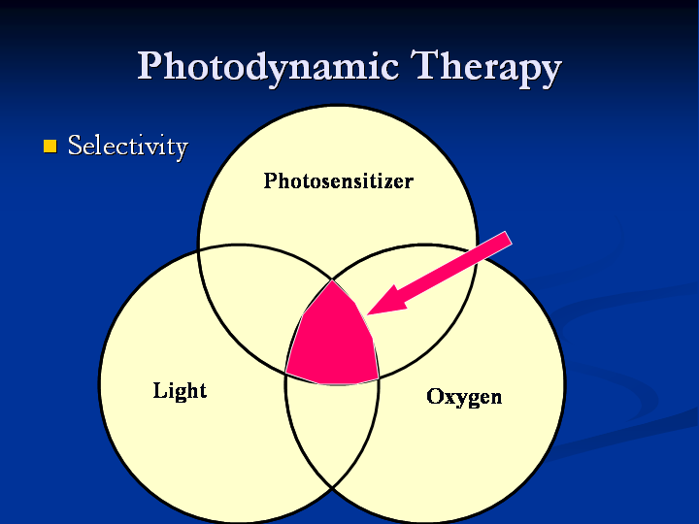
The principle of modern PDT applications involve three key components:
1- Photosensitizer, 2- Light source and 3- Tissue Oxygen.
The combination of these three components leads to the chemical destruction of any tissues which have selectively taken up the photosensitizer and locally exposed to light. The wavelength of the light source needs to be appropriate for exciting the photosensitizer to produce reactive oxygen species (ROS). These reactive oxygen species generated through PDT are free radicals (Type I PDT) and singlet oxygen (Type II PDT) lead to both necrosis (cell death) and apoptosis (‘programmed’ cell death).

Slide 5
The principle of modern PDT applications involve three key components:
1- Photosensitizer
+
2- Light source
+
3- Tissue Oxygen.
Photochemical
reaction
Reactive oxygen species
(singlet oxygen, free radicals, superoxide, peroxide )
Selective
tissue destruction
( kill cancer cells)

Slide 6
Photosensitizers
Photosensitizers are drugs (chemical compounds) that activated only by light of a specific wavelength and in the presence of molecular oxygen, generate reactive oxygen species (ROS) which selectively lead to destruction of tumor tissues.
There are many different types of compounds that can be used as photosensitizers, , such as Photofrin, Levulan, Allumera, Visudyne, Foscan, Metvix, Hexvix, Cysview, and Laserphyrin,
with others in development, e.g. Antrin, Photochlor, Photosens, Photrex, Lumacan, Cevira, Visonac, BF-200 ALA. Amphinex. Also Azadipyrromethenes.
The major difference between different types of photosensitizers is in the parts of the cell that they target. For example:
ALA has been found to localize in the mitochondria and Methylene Blue in the lysosomes. While mTHPC has been shown to localize in the nuclear envelope and do its damage there.
Hematoporphyrin derivative ( HpD, under the pharmaceutical name Photofrin) was the first photosensitiser approved (U.S. Food and Drug Administration ) for clinical use in 1993 to treat a form of bladder cancer in Canada.

Slide 7
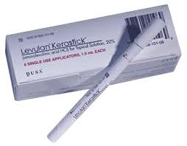
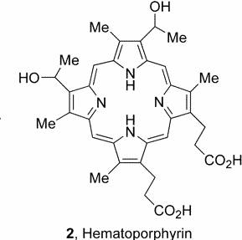
What photosensitizers are available, and how are they applied?
The two currently photosensitizers available in the market under the trade name ( Photofrin and Levulan).
Photofrin is a heterogeneous mixture of ( Hematoporphyrin derivative, HpD) . It is used intravenously for internal cancers (Bladder, oesophageal, lung Ca)
Levulan is composed of ( 5-aminolevulinic acid, ALA). Levulan is commonly applied topically for skin therapy (Actinic keratosis, and Acne vulgaris).

Slide 8
What light sources are available?
Laser or non-laser light ( intense pulsed light, light-emitting diodes (LEDs), blue light, red light, and many other visible lights including sunlight).
Laser light has the advantages of being:
Monochromatic ( single wavelength that corresponds with the peak absorption of the photosensitizer drug).
Coherent and collimated (able to focus light waves to specific site).
Intense (high irradiance allowing for shorter treatment times).
How are they applied?
For surface skin treatments: The light is easily directly applied to the area of the skin where the photosensitizer drug has been applied (i.e. face, scalp, arms, etc.).
For internal cancers: The light may be delivered through small optical fiber by Endoscopy into the body cavity or area being treated (Bladder, lungs, esophagus, or stomach).

Slide 9
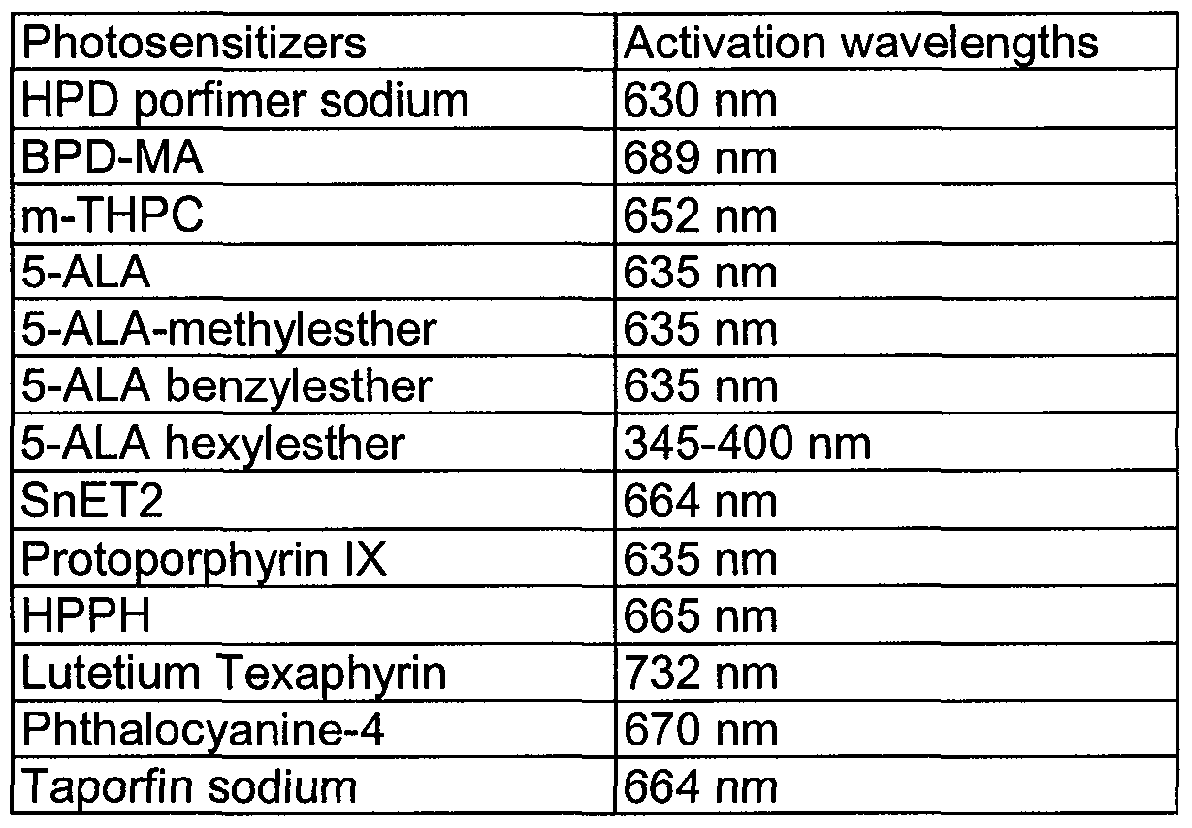
Light source wavelength depends on the photosensitizer absorption

Slide 10
Although these photosensitizers can be used for different treatments, they all aim to achieve certain characteristics (Criteria) :
  Low dark toxicity (The photosensitizer should not be harmful to the target tissue until the light beam is applied).
  Highly tumor-targeting accumulation (highly tumor selective),
  Fast elimination and rapid clearance from the body.
  Absorption peaks in the therapeutic window of biological tissues (Highly absorbed and activated in the near infrared where tissue is most transparent),
  Highly efficient ( production of a highly reactive oxygen species in vivo).
  Available manufacturing and synthesis,
  High solubility in water, injection solutions, and blood substitutes, as well as
  Storage and application light stability.

Slide 11
Procedure of PDT:-
PDT performed clinically as follow:
First, a photosensitizer, e.g. hematoporphyrin derivative (HpD), is injected into a vein of the patient (2.5-5mg/Kg) body weight are applied.
Within the next few hours, HpD is distributed among all soft tissues except the brain. The basic characteristic of a photosensitizer is that it remains inactive until irradiated.

Slide 12
The initial concentration is the same in healthy cells and tumor cells, but the clearance is faster in the healthy cells. After about three days, the concentration of HpD in tumor cells is about thirty times higher than in healthy cells. Its concentration in tumor cells has not decreased much even after a period of 7–10 days. Thus, tumor cells show a longer storage ability (affinity) for HpD.
Laser irradiation usually takes place after the third day and up to the seventh day after injection (sometime several treatments are necessary). Within this period, tumor cells are still very sensitive and selective necrosis of tumor cells is enabled.

Slide 13
Fig. Scheme of photodynamic therapy

Slide 14
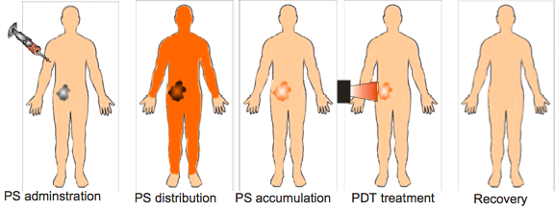
Figure. Scheme of the stages of PDT treatment for a patient with cancer. Photosensitizer (PS) is injected usually into the bloodstream, and distributes around the body. After some time, the PS tends to be cleared from normal tissues, but is retained in cancerous tissue, due to various abnormalities in tumors. This is thought to be the most advantageous time to deliver light.

Slide 15

Procedure of PDT:-
light
O₂
drug
S₀
T₁
¹O₂
PDT
GROUND STATE
GROUND STATE O₂

Slide 16
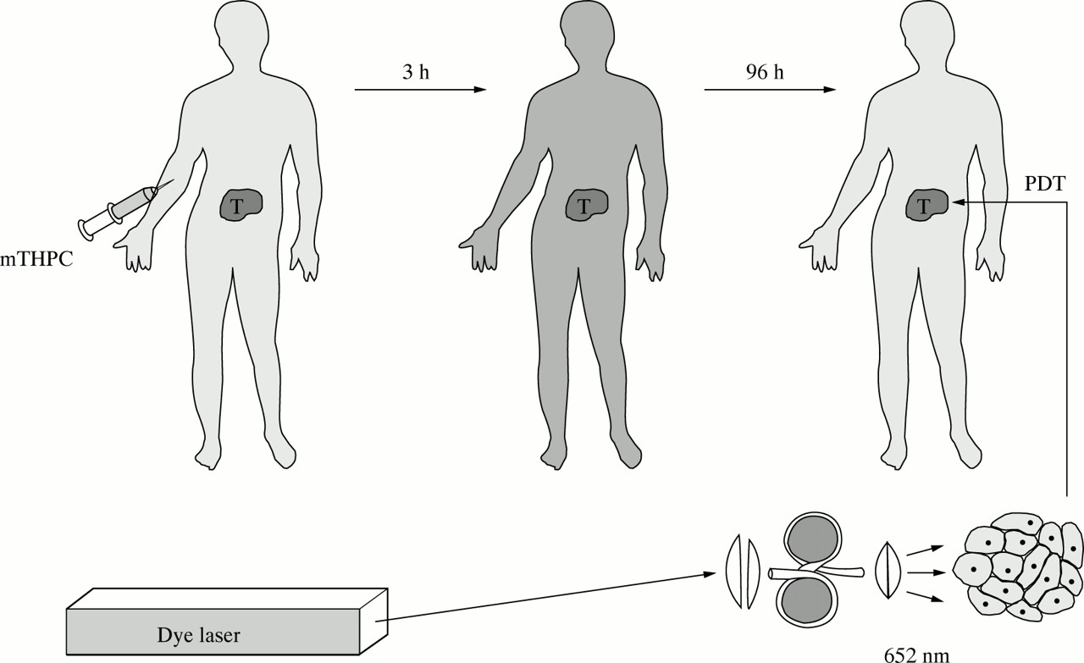
Principles of photodynamic therapy and the laser system.
Ell C et al. Gut 1998;43:345-349

Slide 17
Mechanisms and Pathways of photochemical treatment (PDT) :-
The main idea of photochemical treatment (PDT) is to use a chromophore receptor acting as a catalyst. Its excited states are able to store energy transferred from resonant absorption, and their deactivation leads to generating highly toxic Reactive Oxygen Species (ROS) to kill cells. The term ‘reactive oxygen species’ includes a number of different molecules, including peroxides, free radicals, oxygen ions, etc. all of which are highly reacting, and therefore react with, and damage, cellular components and the cell membrane and so causing cell death). Therefore, this type of interaction is also called photosensitized oxidation.
When a photosensitive molecule ( photosensitizer) is in its singlet ground state, call it ¹S, and it absorbs a photon(hʋ), it is first transferred to an excited singlet state ¹S∗. Then, one of several simultaneous or sequential decays can happen:
1. Radiative singlet decay, ¹S∗ → ¹S + hʋ, i.e. fluorescence, lower energy photon emitted a few nanoseconds after absorption. Photosensitizers often exhibit fluorescence and so can be used to detect as well as treat tumours.
2. Non-radiative singlet decay, ¹S∗ → ¹S, with the energy being lost through vibrational relaxation.
3. Conversion to a triplet state via an intersystem crossing.

Slide 18
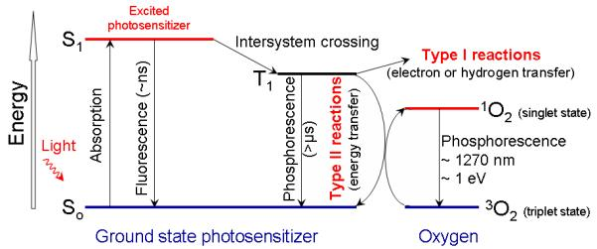
If one of the energy levels for S in an excited singlet state, ¹S∗, happens to be similar to an energy level with S in an excited triplet state, ³S∗, then the molecule may convert to this triplet state: this is called an intersystem crossing. The triplet state is a relatively stable and long-lived state, and can undergo reactions that result in ROS. There are thought to be two main types of reaction, named Type I and Type II. The Type II reaction, which creates excited singlet oxygen ¹O*₂, a very reactive species, from the usual triplet form ³O₂ is considered the most important for photodynamic therapy. ³S∗+ ³O2→ ¹S+ ¹O∗₂

Slide 19
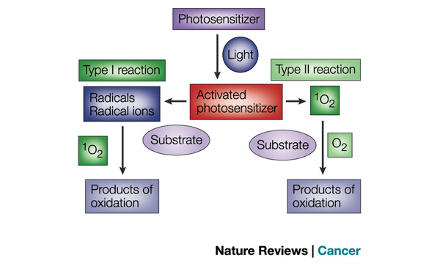
There are two types of reaction during PDT.
Following the absorption of light, the photosensitizer is transformed from its ground state into an excited state. The activated photosensitizer can undergo two kinds of reaction.
Type I reaction, it can react directly with the substrate (a molecule),transferring a hydrogen atom to form radicals. The radicals interact with oxygen to produce oxygenated products (¹O₂)
Type II reaction, the activated photosensitizer can transfer its energy directly to oxygen, to form singlet oxygen (¹O₂) — a highly reactive oxygen species.
NOTE: Excited singlet oxygen ¹O∗₂ is very reactive, thus leading to cellular oxidation and necrosis. To avoid additional oxidation of healthy cells, Carotene is injected after laser exposure which then promotes the toxic singlet oxygen to harmless triplet oxygen.

Slide 20
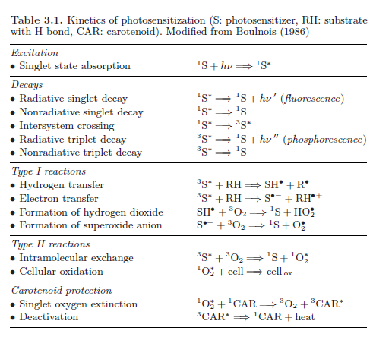
Mechanisms and Pathways of photochemical treatment (PDT) :-

Slide 21
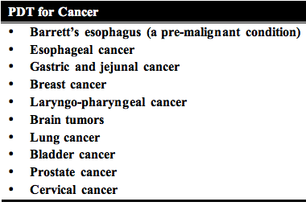
Applications of PDT:
There are many potential applications for PDT, but here are some of the more commonly used treatments:
Table. List of common tumor types that have been treated by PDT.

Slide 22
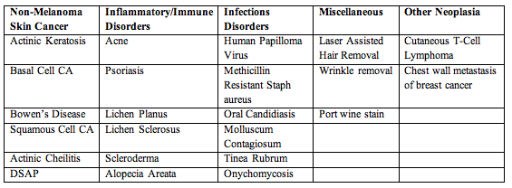
Table. Dermatologic conditions treated by PDT.

Slide 23
Table. Dermatologic conditions treated by PDT.
Skin cancer | Inflammatory and immune disorders | Infectious disorders | Miscellaneous
Actinic keratosis | Acne Photorejuvenation | Methelin Resistant Staph aureus | Laser assistant hair removal
Basal cell CA | Psoriasis | HPV Oral Candidiasis | Wrinkle removal
Bowens disease | Lichen Planus Lichen Sclerosis | Mollusum Contagiousum | Portwine stain
Squamous cell CA | Alopecia Areata Scleroderma | Tinea rubrum Onychomycosis | Cutaneous T-cell lymphoma

Slide 24
How PDT kills the cancer cells ?
PDT induces cell damage through direct and indirect ways.
Direct: by Photochemical reactions that generating Reactive oxygen species (singlet oxygen, free radicals), which are very toxic to the tissue so leading to tissue necrosis and apoptosis (cancer cell death).
Indirect: PDT appears to shrink or destroy tumors in two other ways:-
A- The photosensitizer can damage blood vessels in the tumor, thereby preventing the cancer from receiving necessary nutrients.
B- PDT also may activate the immune system to attack the tumor cells.

Slide 25
Successful PDT:
The extend of photodamage and cytotoxicity:- is multifactorial and depends on:
The type and the dose of photosensitizer
The site and size of the tumor
The time interval between the administration of the photosensitizer and the light irradiation.
The light source parameters :The wavelength, intensity, duration of illumination, light exposure dose and, ….. etc.
The oxygen availability in the target tissue.

Slide 26
Advantages of PDT :
Photodynamic therapy is a great new cancer treatment because it is highly effective, often resulting in more than 80% cell kill.
Photodynamic therapy is applied when surgery is contraindicated because of the tumor spread and serious associated medical diseases.
Photodynamic therapy is more selective for cancer cells (targeted at tumor cells). A photosensitizer is selectively accumulated in a tumor, and it is rapidly eliminated from healthy cells that surround the tumor. Due to this, light selectively damages the tumor, whereas surrounding healthy tissues remain intact.
Photodynamic therapy treats a region exposed to light. As a result, avoids the systemic side effect on the human being (as in the case of chemotherapy systemic S.E, such as nausea, vomiting, stomatitis, loss of hair, and inhibition of hematopoiesis).
Photodynamic therapy is a noninvasive or minimally invasive method and it is much less invasive than any other form of cancer therapy, such as chemotherapy or radiation treatment
Photodynamic therapy is cost-effective and inexpensive technique, which can treat a variety of malignant tumors .

Slide 27
Disadvantages of PDT:
There are several disadvantages to the current methods of photodynamic therapy
1- The major disadvantage of HpD is the fact that the patient needs to remain in a dark room during the first weeks of therapy. This is necessary, because HpD is distributed all over the body, and sun light or artificial light would kill healthy tissue cells, as well. (i.e. For treatment with Photofrin, the patients will remain photosensitive up to 2 months and must protect themselves from light.
2- Another minor disadvantage of photodynamic therapy is that the time between drug administration and irradiation is frequently inconvenient, between 12 and 14 hours for aminolevulinic acid and 24 -72 hours for Photofrin.
3- Unfortunately photodynamic therapy can not treat metastasized cancers.
4- PDT for infections is likely to be applied exclusively to localized disease, as opposed to systemic infections such as bacteremia.
5- The production of HpD is very expensive.
6- Contraindications to photodynamic therapy include a history of porphyria and allergy/photoallergy to active ingredients of the applied photosensitizer.

Slide 28
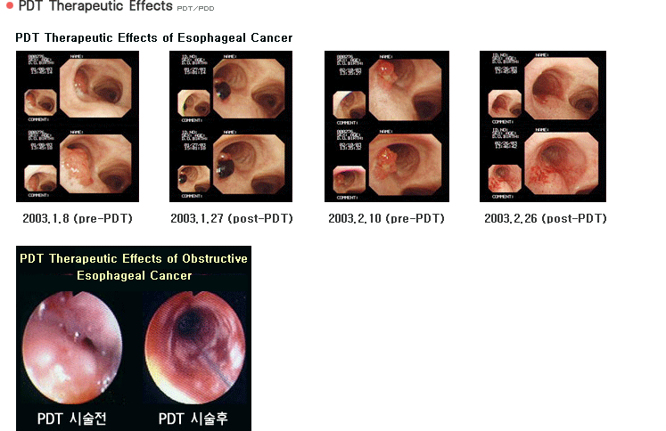
Examples:-
PDT of Obstructing esophageal Cancer
Photofrin (1.5 to 2.0 mg/kg) was administered.
After 48 hours, laser light irradiation with 630 nm.
90.8% of patients showed a significant improvement in the mean dysphagia score at 4 weeks post- PDT.

Slide 29
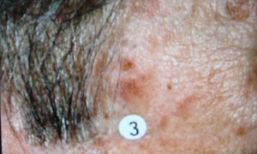
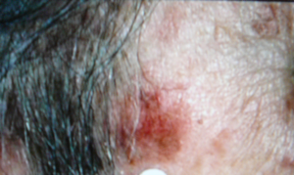
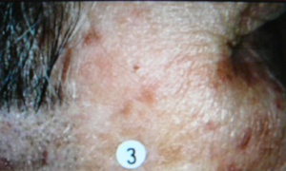
PDT for Skin Cancer.
A-
B-
C-
Figure 4. Photodynamic Therapy for Skin Cancer.
A- Malignant skin lesion . A photosensitizer was administered to this patient.
B- The lesion immediately after laser illumination with red light at 630 nm, . a wavelength that is absorbed by the photosensitizer.
C- The lesion gradually clears, leaving behind only normal skin cells.

Slide 30
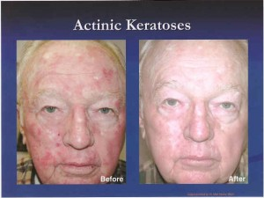
PDT of Actinic keratosis (AK)
Actinic keratosis (AK) is a very common skin problem found in patients over 50 years of age, representing an in situ keratinocytic neoplasm that can progress to invasive squamous cell carcinoma of the skin. One FDA-approved treatment for AK of the face and scalp is photodynamic therapy (PDT) with 20% aminolevulinic acid (ALA). This advanced technology has been demonstrated in clinical trials to be effective and well tolerated by patients.

Slide 31
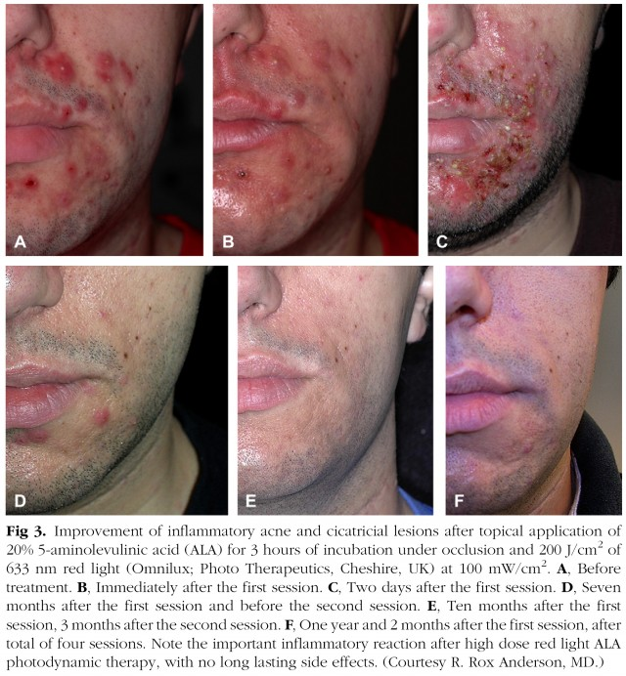
PDT of inflammatory Acne

Slide 32
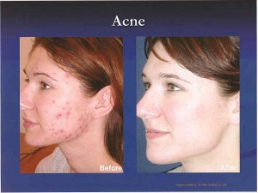
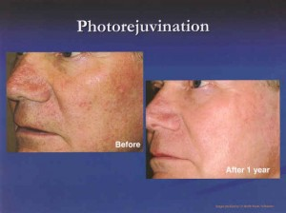

Slide 33
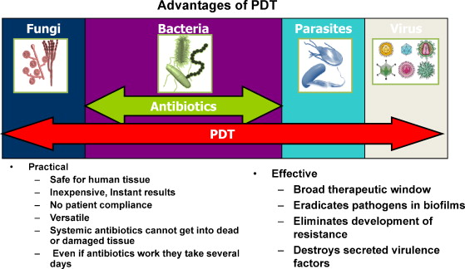
PDT for infectious disease
There were many reports of photodynamic inactivation (PDI) of various species of bacteria and fungi, parasites as well as viruses.(Broad spectrum antimicrobial ).

